Slide 1
Reproductive System and Health
Sexuality, Health and Responsibility Education- 8th Grade

Slide 2
Biological Male Anatomy

Slide 3
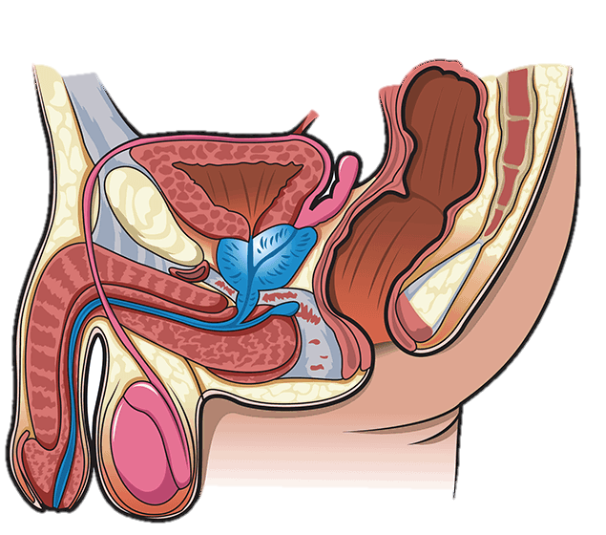
bladder
seminal vesicle
vas deferens
prostate gland
urethra
Cowper's gland
penis
testicle
epididymis
scrotum

Slide 4
Biological Female Anatomy

Slide 5
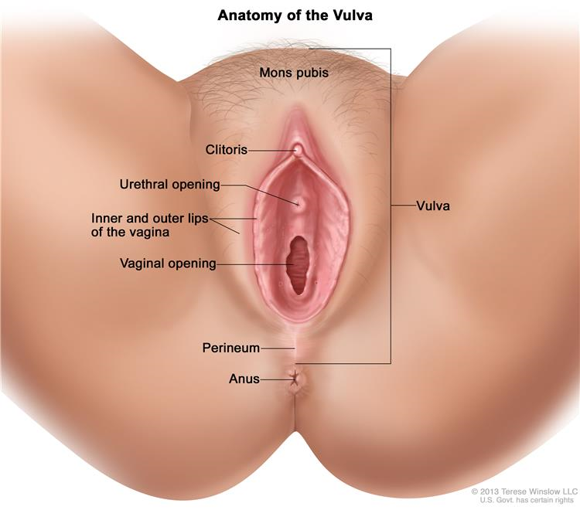

Slide 6
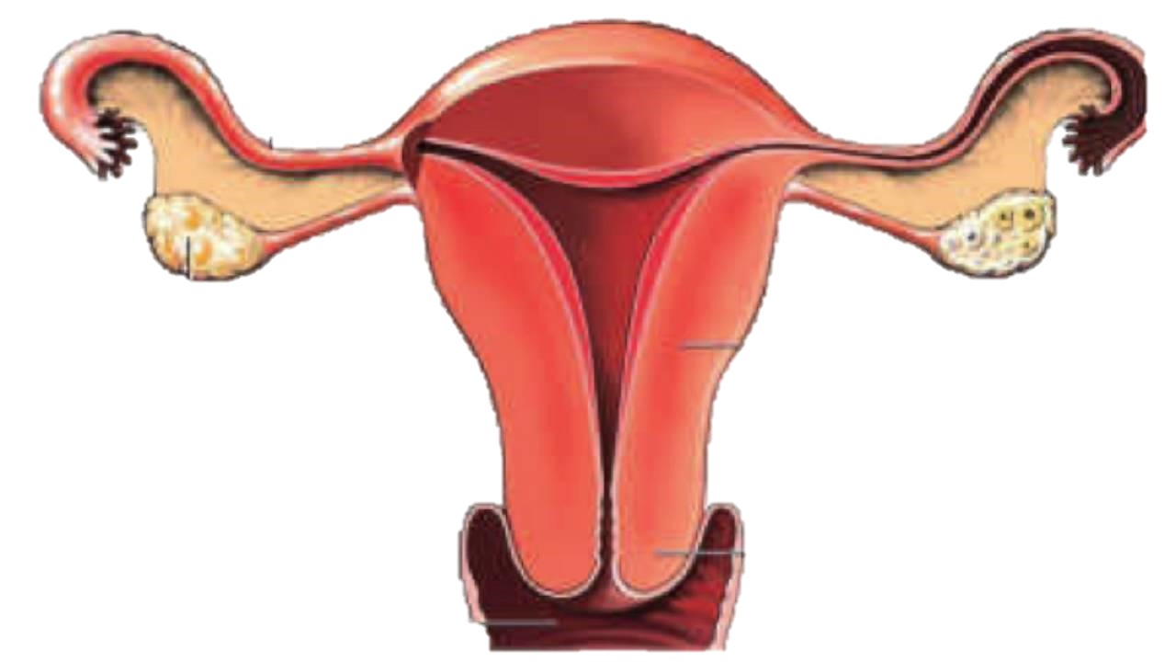
Fallopian tube
ovary
Uterus
cervix
vagina

Slide 7
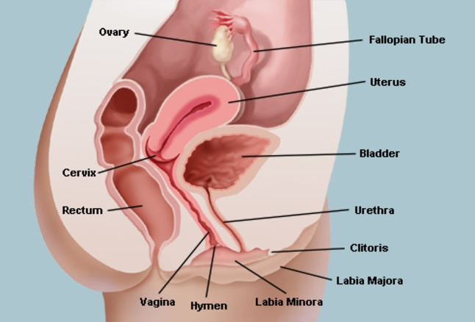

Slide 8
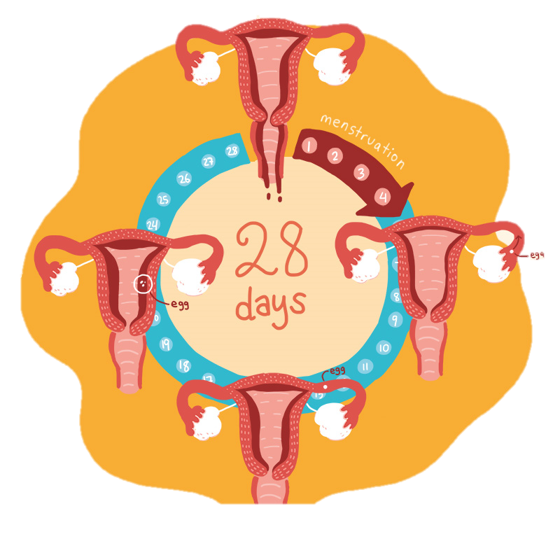
Stage 1 (1-7 days)
Lining flows out of the uterus through the vagina. This is menstruation, or the period.
Stage 4 (about 14 days)
Egg travels to uterus. If it’s not fertilized, it leaves the body with the next period.
Stage 2 (6-12 days)
Egg matures in the ovary and uterus lining gets thicker.
Stage 3 (about 14 days before next period)
Egg is released from ovary and moves into fallopian tube.
Notes:
Important to note: For the first few years after a female starts her period, it may not come regularly. This is normal at first. By about 2-3 years after her first period, a females periods should be coming around once every 4-5 weeks. Just because a female has an irregular cycle does not mean she cannot get pregnant. Contraception for both partners should always be used when engaging in any sexual activity.

Slide 9
Pregnancy and Reproduction Explained

Slide 10
WCSD Definition of Abstinence
Sexual abstinence is defined as refraining from all forms of sexual activity and genital contact such as vaginal, oral and anal sex.
An abstinent person is someone who has either never had sex or someone who's had sex but who has decided not to continue having sex for a period of time.
Abstinence is the only 100% effective way to prevent HIV, other sexually transmitted diseases or infections and pregnancy.
SEX – when a person’s genitals touch another person’s genitals, mouth or anus.

Slide 11
Early Pregnancy Symptoms
Missed period
Swollen or tender breasts
Nausea and/or vomiting
Feeling tired
Bloating
Constipation
Peeing more often than usual

Slide 12
How Can I Reduce my Sexual Health Risk?

Slide 13
Talk to a trusted adult
Even if you’re worried that talking to your parents about your body and sexual health will be awkward, it’s a good idea to ask for their help (as long as you feel safe).
Your parents were your age once, and they know what it’s like to be a teenager.
They might even be proud of you for being responsible about your health

Slide 14
Going to see a medical health care provider
Going to the doctor is an important part of making sure you stay healthy.
Doctors can also answer any questions you have about puberty, your body, and sex.

Slide 15
Things to talk about with your doctor
have had vaginal sex, oral sex, or anal sex
have had unprotected sex (sex without a condom or dental dam)
think you might have an STD
feel any pain, itching, or discomfort in your genitals (penis, testicles, vagina, vulva, or anus)
have really bad cramps, PMS, or other problems with your periods
notice any lumps in your testicles
Feel a lump in your breast or vulva
think you might be pregnant
don’t feel safe in a relationship or at home

Slide 16
Things to remember…
Doctors and nurses ask lots of questions so they can figure out if it’s good idea to give you certain tests, help you use birth control, or talk with you about your relationships.
There’s no need to be embarrassed about answering those questions
— there are no wrong answers!

Slide 17
Keep in mind:
Your body? You’re the boss. If you don’t want a particular exam or test, or you want them to stop something they’ve already started, it’s OK to say stop.
Ask why. You’re allowed to ask your doctor or nurse why they want to do whatever exam, test, or procedure they say you need. You have a right to know, and to feel safe about what they’re doing. This idea is called “informed consent.” Plus, health care professionals are usually happy to educate you about your body.
You can change doctors. Didn’t feel safe with the doctor or nurse you visited? Find out if there’s someone else in your area you can go to for your health care. It’s good to find someone you can trust — and it’s OK if it takes a few tries.
If anything happens during your appointment that doesn’t feel right or makes you feel unsafe, let and adult you trust know about it.
Notes:
This is consent

Slide 18
Local Resources
Washoe County Health District: Teen Health Mall/Clinic 775-328-2470
Northern Nevada HOPES 775-786-4673
Planned Parenthood of Northern Nevada 775-688-5555
Crisis Call Center: text “listen” to 839863
Suicide Prevention Lifeline 1-800-273-8255
LGBTQ+ Friendly Services: https://www.nnhopes.org/patients/services/lgbtq/

